Slide 1
Stresses due to Bending
Chapter 7

Slide 2
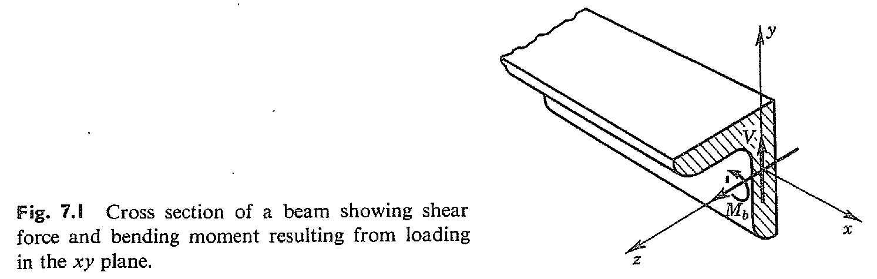
Introduction

Slide 3
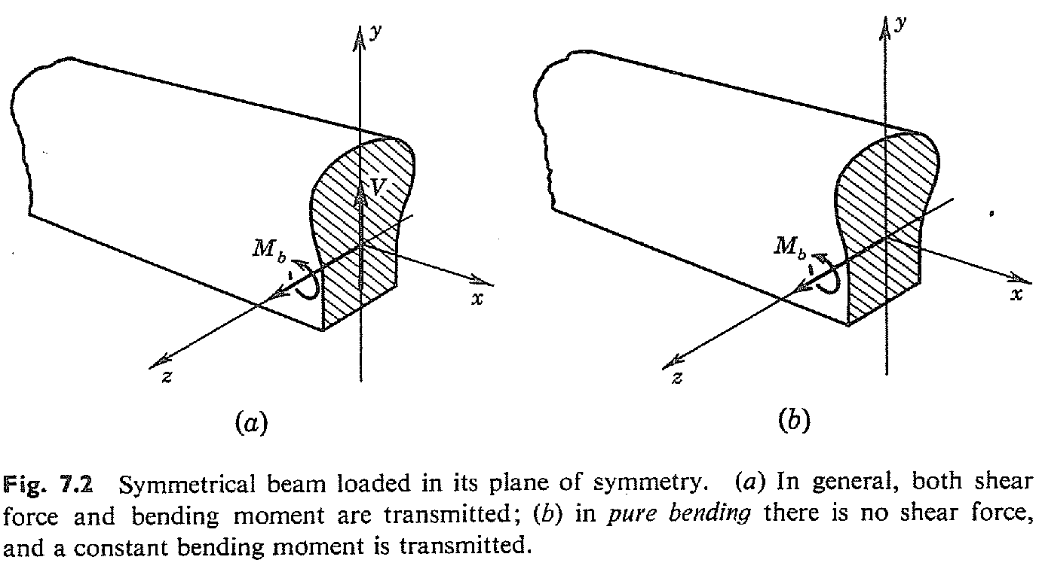
Geometry of deformation of a symmetrical beam subjected to pure bending

Slide 4
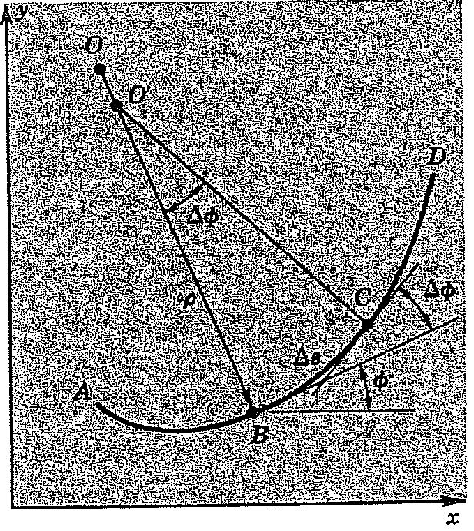
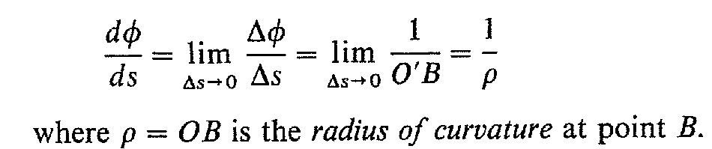
Material properties are constant along the length of the beam and symmetrical with respect to the plane of loading
Beam transmits a bending moment which is constant along its length (pure bending)
Originally straight beam will deform into a curved shape.
Curvature:
The rate of change of slope angle of the curve with respect to the distance along the curve

Slide 5
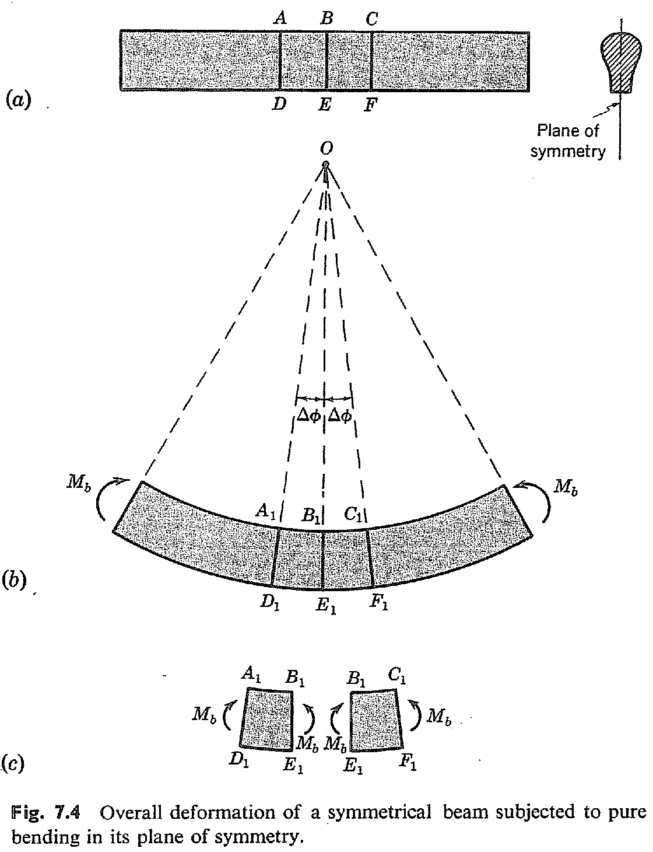

Slide 6
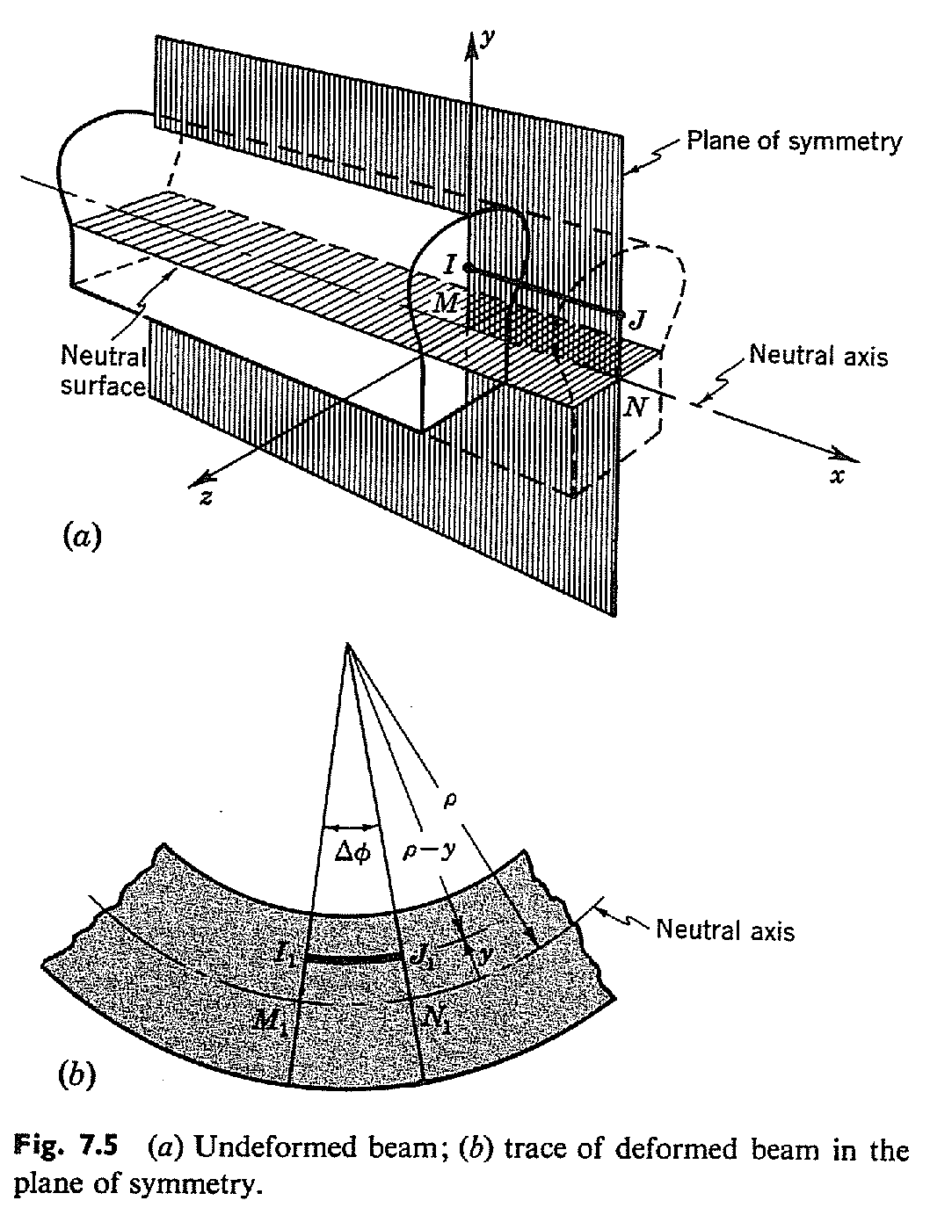

Slide 7
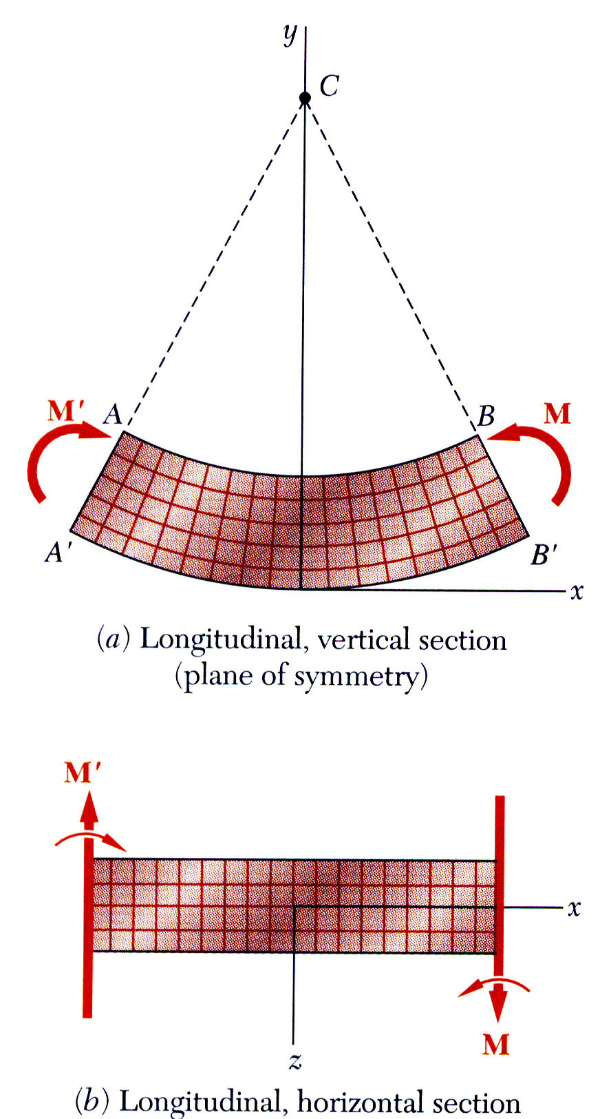
Bending Deformations
Beam with a plane of symmetry in pure bending:
member remains symmetric
bends uniformly to form a circular arc
cross-sectional plane passes through arc center and remains planar
length of top decreases and length of bottom increases
a neutral surface must exist that is parallel to the upper and lower surfaces and for which the length does not change
stresses and strains are negative (compressive) above the neutral plane and positive (tension) below it

Slide 8
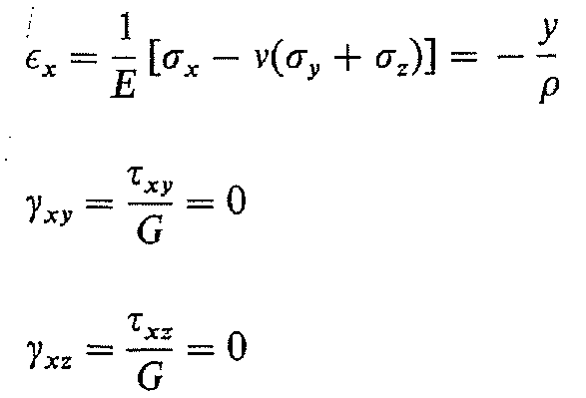
Stresses obtained from stress-strain relations

Slide 9
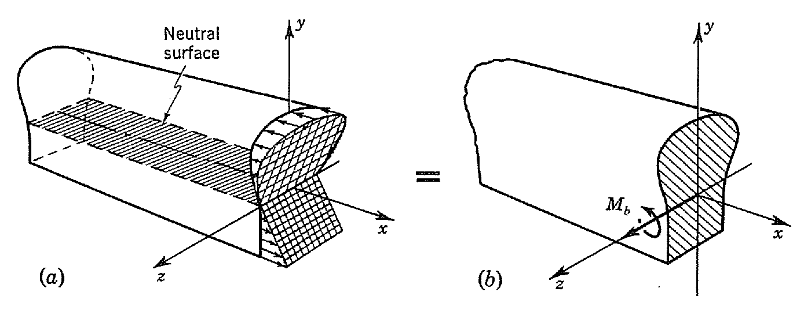
Equilibrium requirements
Equilibrium requires that the resultant of the stress distribution over the cross section of the beam should equal the bending moment M_{b}

Slide 10
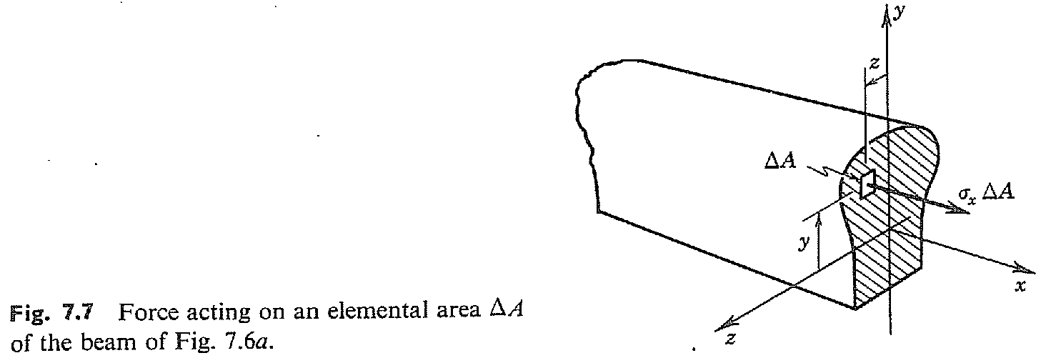

Slide 11
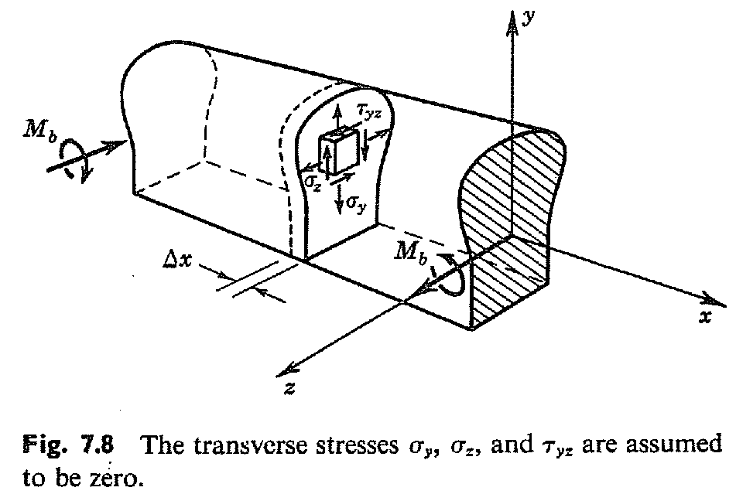
Stress and deformation in symmetrical elastic beams subjected to pure bending

Slide 12

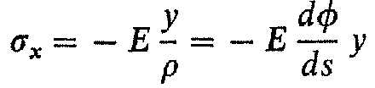
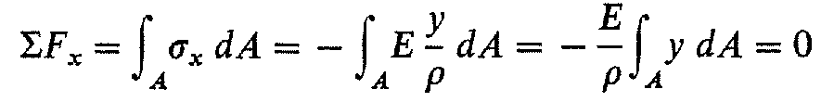
The moment of cross sectional area about the neutral surface must be zero.
The neutral surface must pass through the centroid of the cross-sectional area

Slide 13
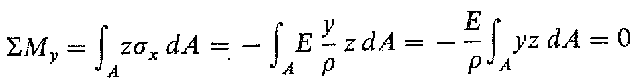
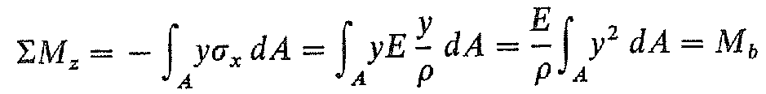
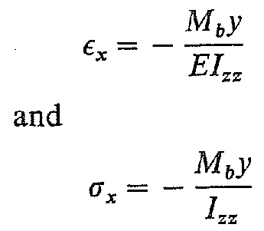
Cross-section w.r.t. the xy plane symmetrical

Slide 14
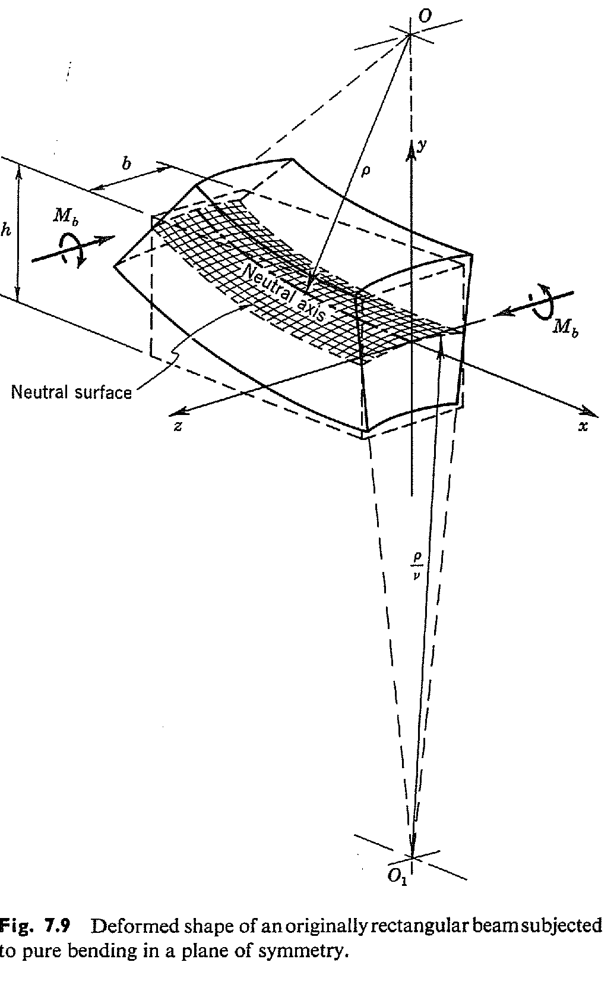

Slide 15
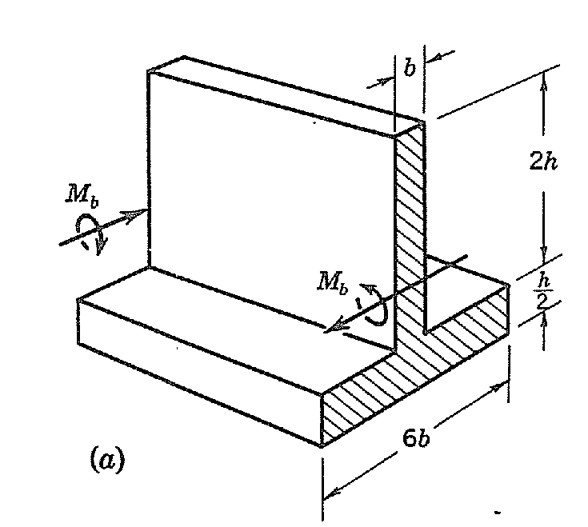
Find the maximum tensile and compressive bending stresses for the symmetrical T-beam, under the action of the constant bending moment M_{b}.

Slide 16
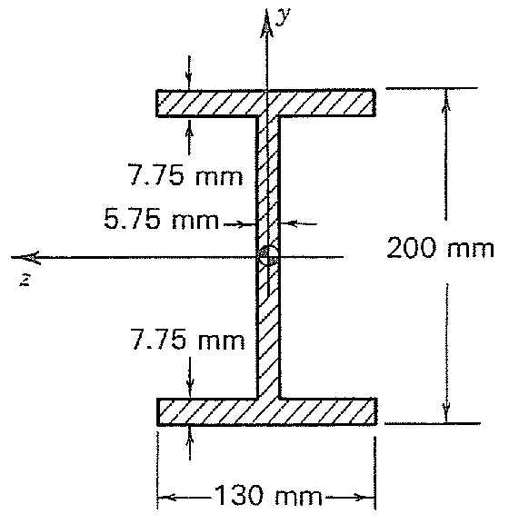
Calculate the moment of inertia I_{zz} for the beam cross section illustrated.

Slide 17
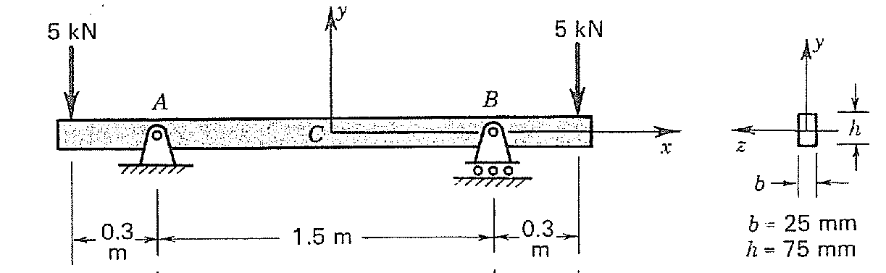

Slide 18
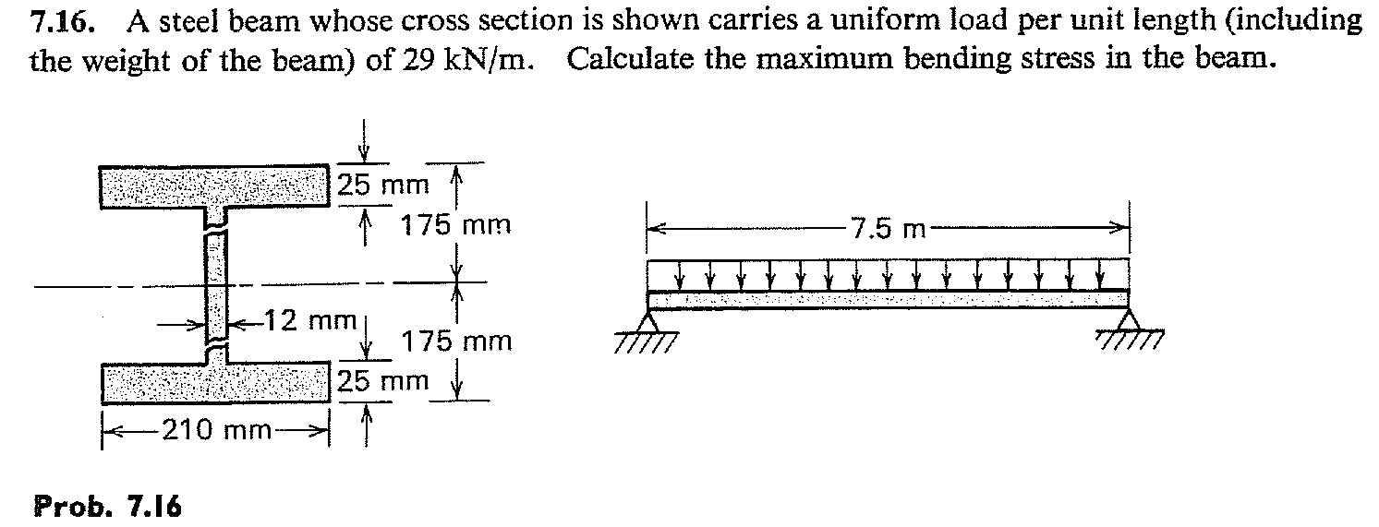
Exercise problem

Slide 19
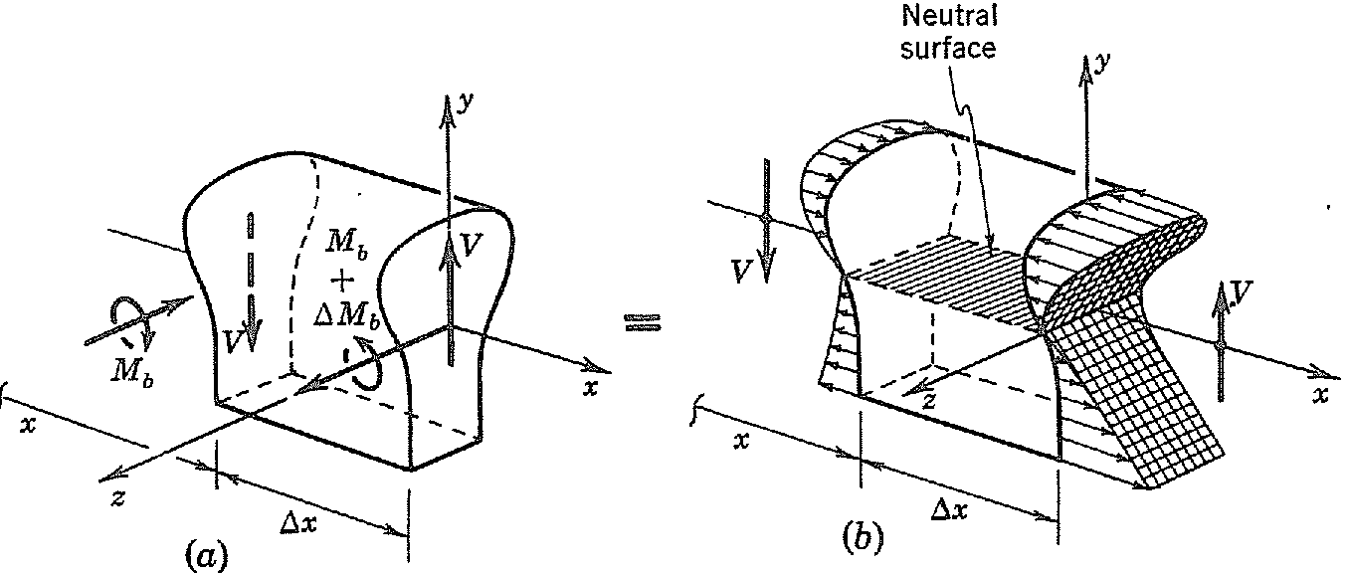
Stresses in symmetrical elastic beams transmitting both shear force and bending moment

Slide 20
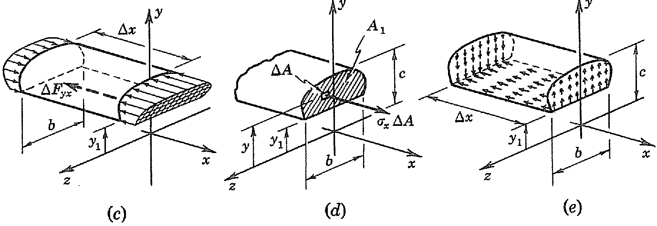
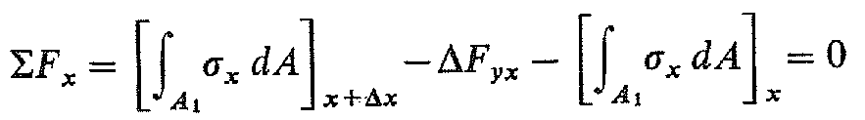
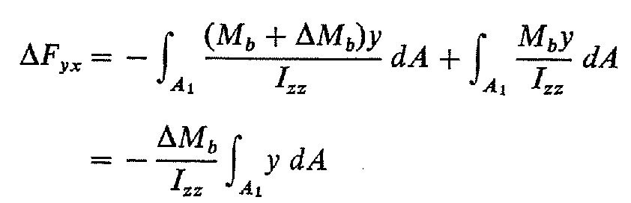

Slide 21
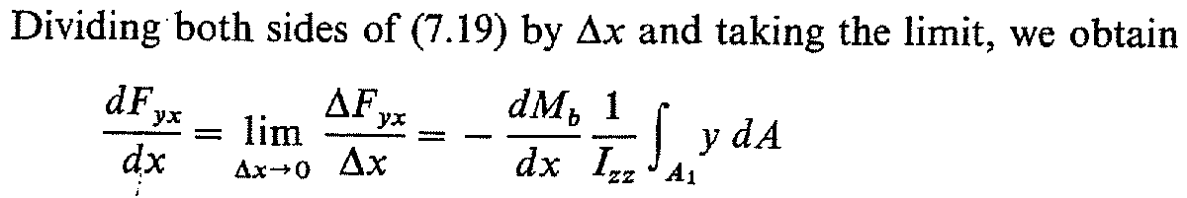
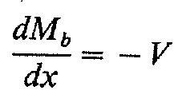
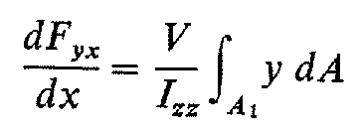
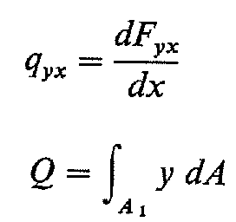
Introducing

Slide 22
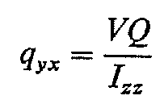
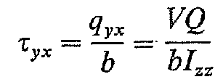
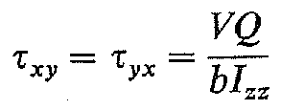
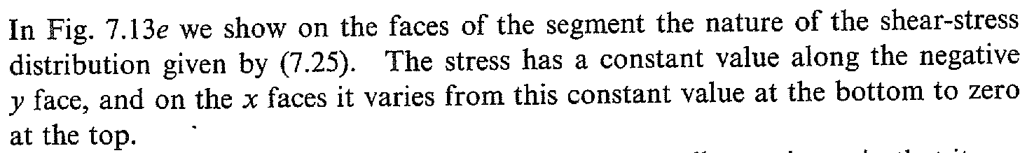

Slide 24
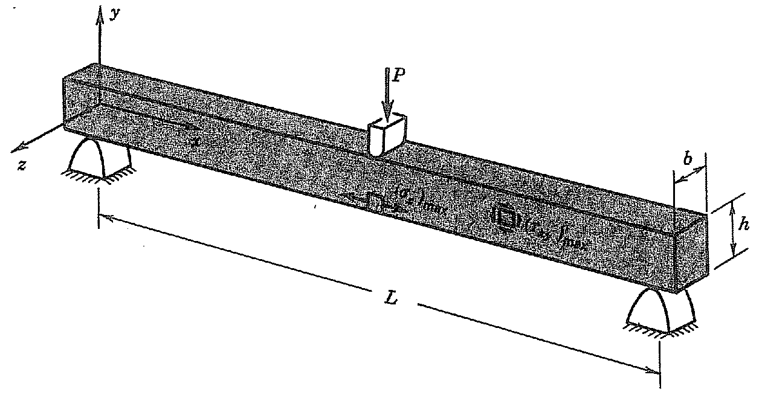
Find the ratio of the maximum shear stress (τ_{xy})_{max} to the maximum bending stress (σ_{x})_{max}.

Slide 25
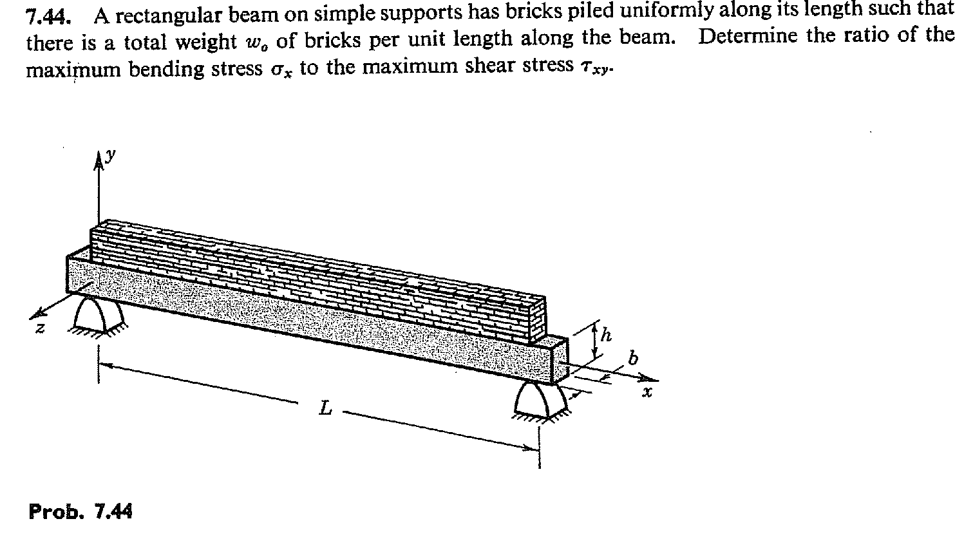
Exercise problem

Slide 26
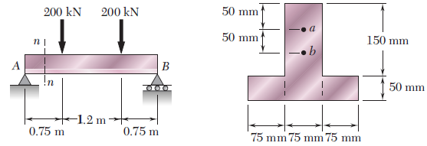
For the beam and loading shown, consider section n-n and determine the shearing stress at (a) point a, (b) point b.

Slide 27
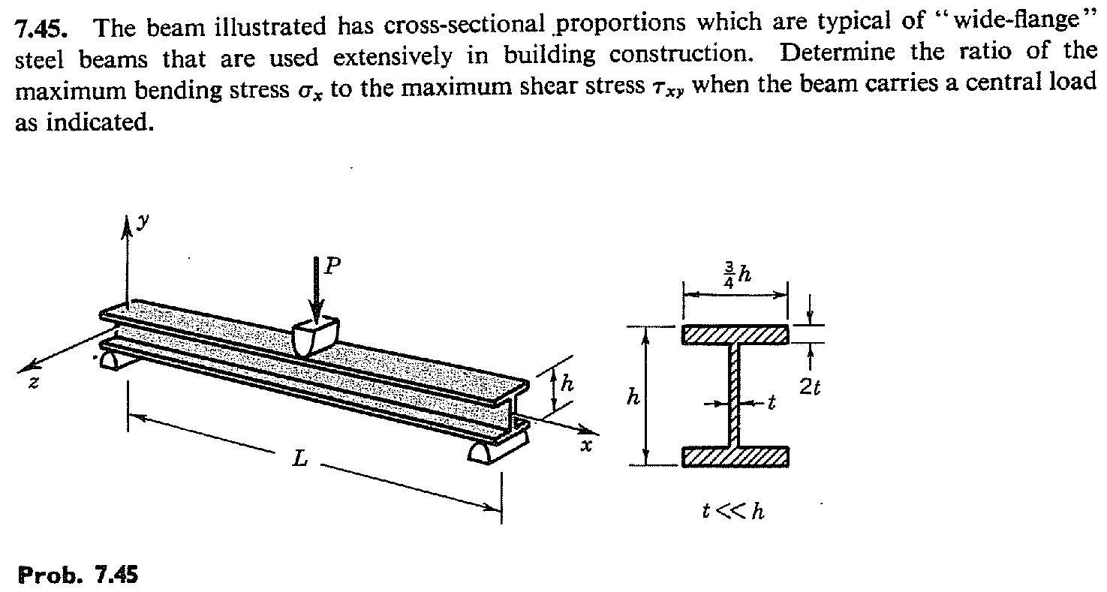
Exercise problem

Slide 28
A simply supported beam having I- cross section, with dimensions shown in Fig., have a span of 5 m. Calculate the intensity of uniformly distributed load which the beam can carry, if maximum permissible bending stresses in compression and tension are 30 N/mm² and 42 N/mm², respectively, and maximum permissible shear stress is 20 N/mm².

Slide 29
The cross-section of a wooden beam is 8cm wide and 12cm deep with a semicircular groove of 2cm radius planned out in the centre of each side. Calculate the maximum stress in the section when simply supported on a span of 3m, loaded with a concentrated load of 450N at a distance of 1m from the left end and a uniform distributed load of 500N/m run over the whole span.
8 cm
450 N
1 m
2 m
500 N/m
12 cm
2 cm

Slide 30
A beam with symmetrical “I” cross section has bending moments M_{b} = 1.5 kN-m and shear force 5 kN at a particular cross section along the length of the beam. Given I_{zz} = 2.164 x 10⁷ mm⁴& E = 210 GPa.
Show the non-zero stresses on a 3-D differential element in equilibrium at points A, B, C, D & E on the cross section. Mark the coordinate axes shown in figure on each of these elements.
Calculate the magnitudes of these non-zero stresses.
7.75
A
B
50
100
C
200
D
50
7.75
E
130
All dimensions in mm

